Slide 1

Be Repentant
Lamentations
Dr. Rick Griffith • Crossroads International Church Singapore
CICFamily.com • BibleStudyDownloads.org

Slide 2
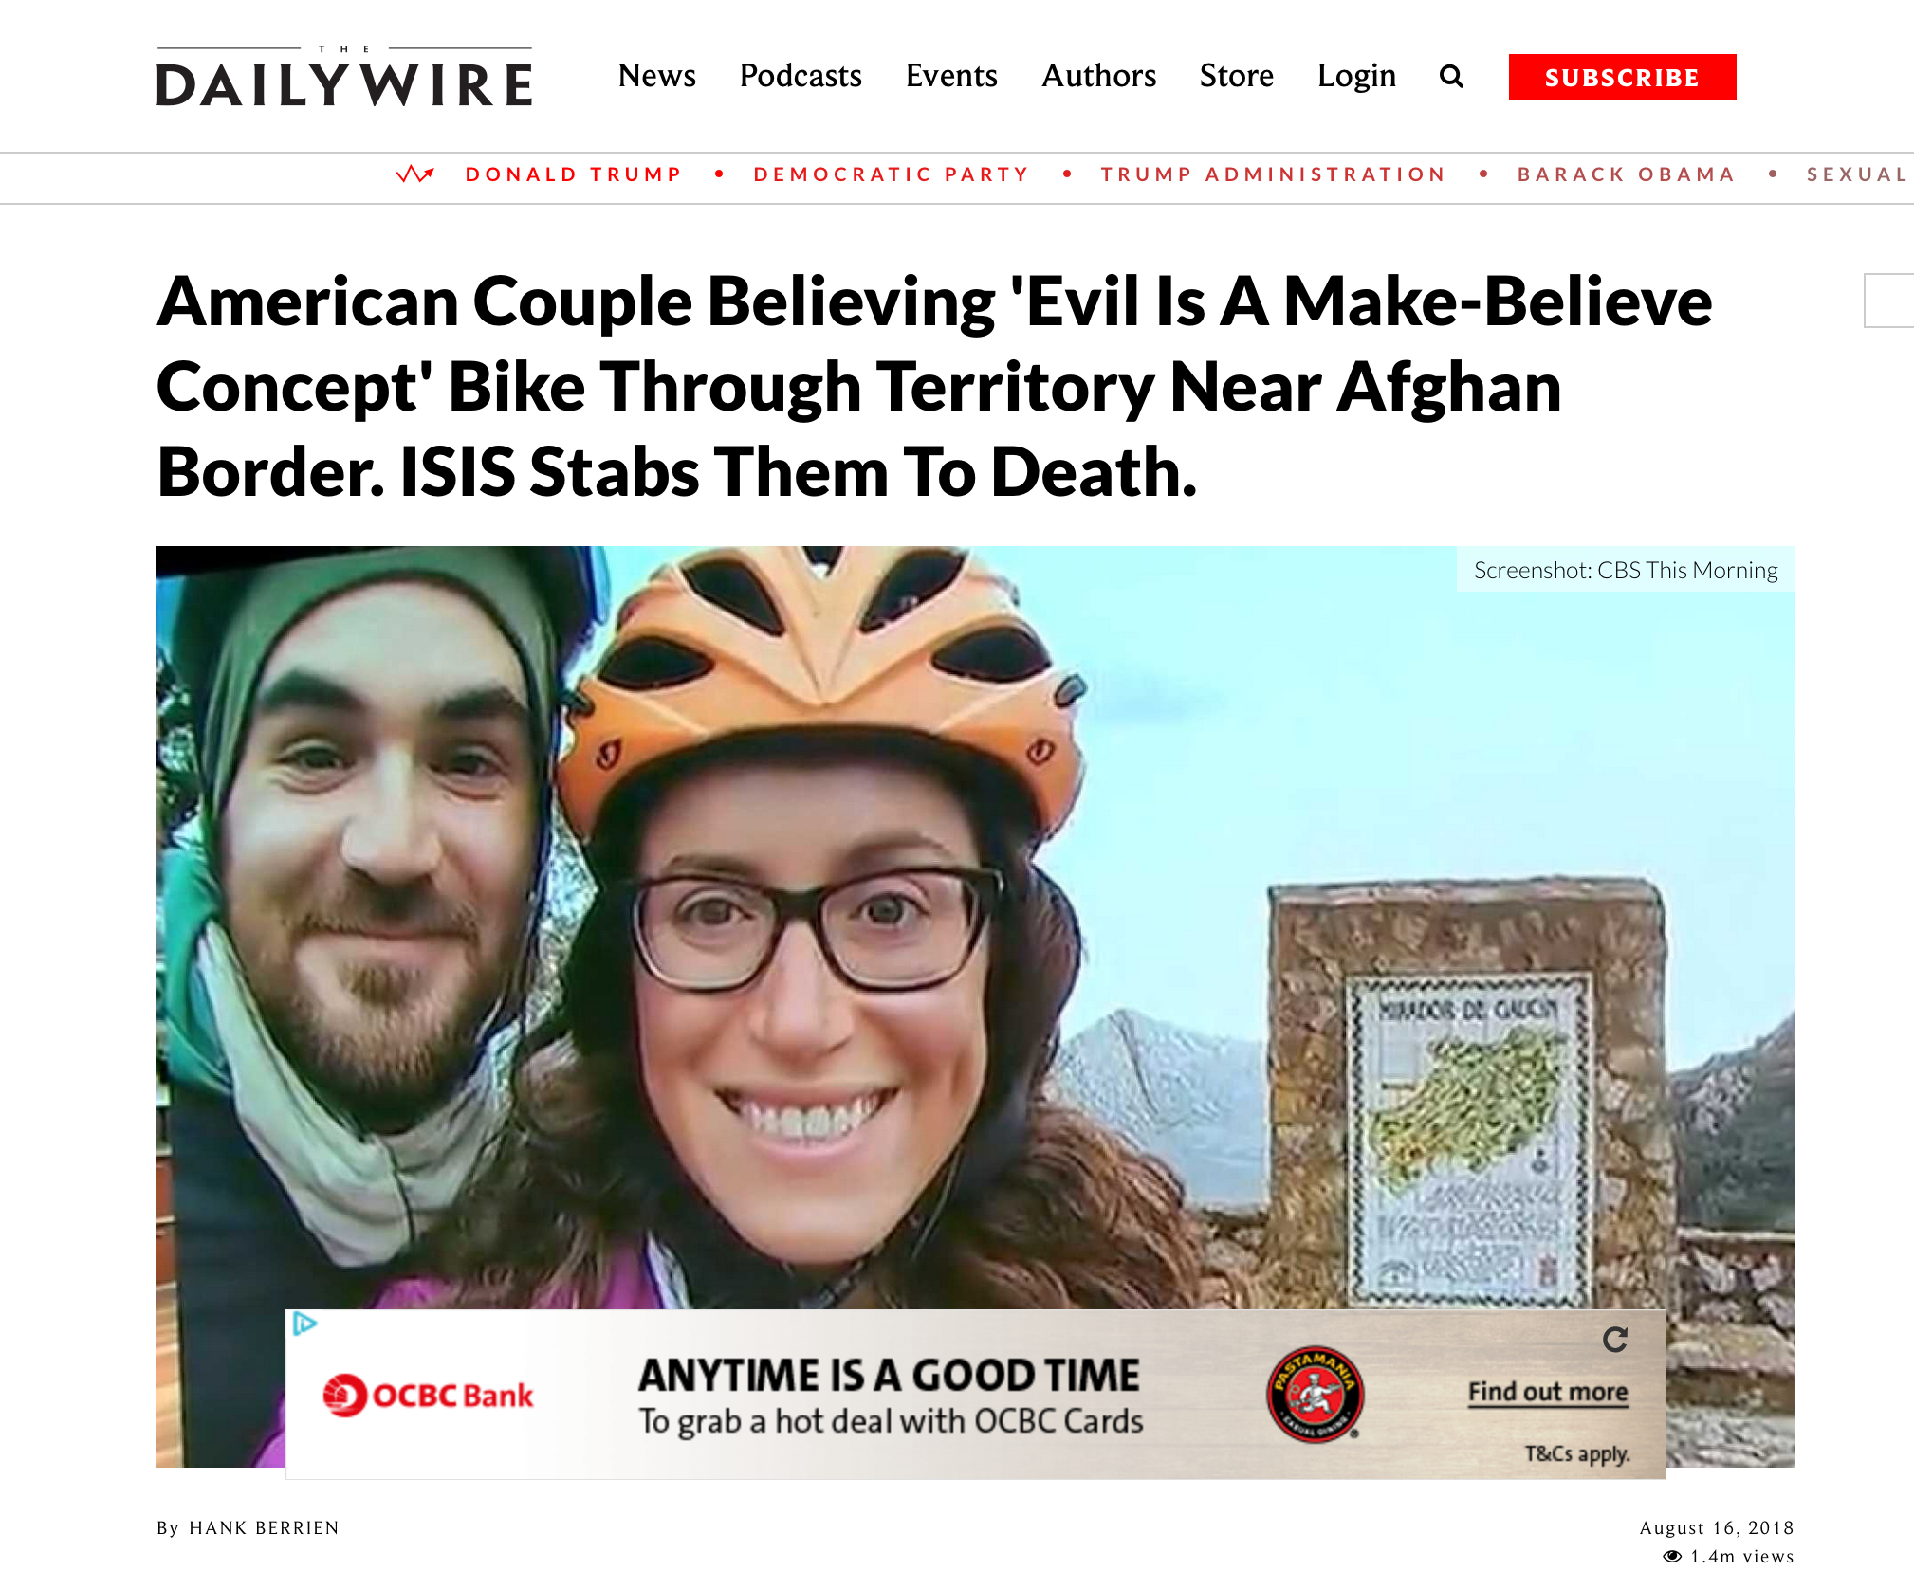
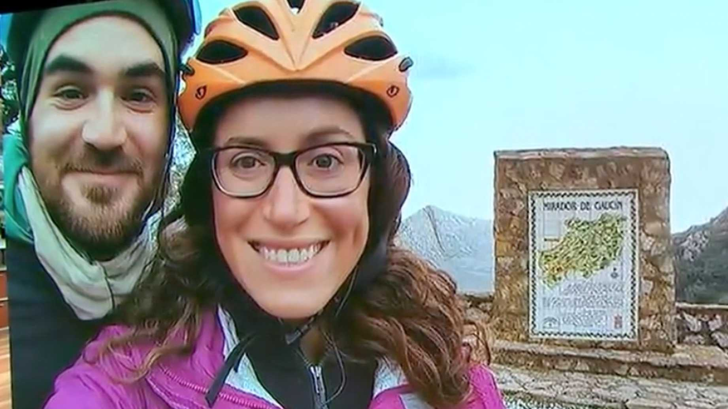
Notes:
“A young American couple who took a year-long bike trip around the world…
Jay Austin and Lauren Geoghegan
[GAY-gen], 29, quit their jobs last year [2017] in order to make their trip. [Jay] was a vegan who worked for the U.S. Department of Housing and Urban Development; [Lauren], a vegetarian who worked in the Georgetown University admissions office.
Austin had a personal blog on which he wrote in June 2017, “I’ve grown tired of spending the best hours of my day in front of a glowing rectangle, of coloring the best years of my life in swaths of grey and beige. I’ve missed too many sunsets while my back was turned. Too many thunderstorms went unwatched, too many gentle breezes unnoticed.”
Their trip, which lasted 369 days, took them from the southernmost tip of Africa in Capetown, South Africa, to Namibia, Botswana, Zambia, Malawi, Tanzania, Egypt, Morocco, Spain, France, Italy, Croatia, Montenegro, Kosovo, Turkey, Kazakhstan, Kyrgyzstan, and finally Tajikistan, where they were [riding] with two other cyclists, one from Switzerland and the other from the Netherlands.
While in Morocco, Austin wrote…
________
American Couple Believing 'Evil Is A Make-Believe Concept' Bike Through Territory Near Afghan Border. ISIS Stabs Them To Death.
https://www.dailywire.com/news/34581/american-couple-believing-evil-make-believe-hank-berrien
Screenshot: CBS This Morning
By Hank Berrien
August 16, 2018 1.4m views
Accessed 15 Sep 2018

Slide 3
American Couple Believing 'Evil Is A Make-Believe Concept' Bike Through Territory Near Afghan Border. ISIS Stabs Them To Death.
…You watch the news and you read the papers and you're led to believe that the world is a big, scary place. People, the narrative goes, are not to be trusted. People are bad. People are evil. People are axe murderers and monsters and worse.
I don't buy it. Evil is a make-believe concept we've invented to deal with the complexities of fellow humans holding values and beliefs and perspectives different than our own—it's easier to dismiss an opinion as abhorrent than strive to understand it. Badness exists, sure, but even that's quite rare. By and large, humans are kind. Self-interested sometimes, myopic sometimes, but kind. Generous and wonderful and kind. No greater revelation has come from our journey than this.
—June 2017 Jay Austin blog entry in Morocco
Notes:
…You watch the news and you read the papers and you're led to believe that the world is a big, scary place. People, the narrative goes, are not to be trusted. People are bad. People are evil. People are axe murderers and monsters and worse.
I don't buy it. Evil is a make-believe concept we've invented to deal with the complexities of fellow humans holding values and beliefs and perspectives different than our own—it's easier to dismiss an opinion as abhorrent than strive to understand it. Badness exists, sure, but even that's quite rare. By and large, humans are kind. Self-interested sometimes, myopic sometimes, but kind. Generous and wonderful and kind. No greater revelation has come from our journey than this.
______________
EXTRA (not for sermon):
Austin also had some contemptuous words for President Trump:
On the television across the room, Al Jazeera plays softly. Donald Trump has just announced his plans to move an embassy from Tel Aviv to Jerusalem, and the Muslim world is visibly upset. Leaving Rabat a week earlier, we'd pedalled right by a massive peaceful demonstration against the relocation. The television broadcasts footage of protests just like that one stewing up all across the Maghreb, the Middle East, and beyond. As a clip plays of a sullen Trump waddling across the screen, I do my best to disappear into the soft plush of the couch cushion behind me. But American as we may be, no one here seems to mind.
Then, on July 29, 2018, as they were riding their bikes with two other cyclists in Tajikistan, five men exited their car and stabbed all the bicyclists to death.
The New York Times reported:
A grainy cellphone clip recorded by a driver shows what happened next: The men’s Daewoo sedan passes the cyclists and then makes a sharp U-turn. It doubles back, and aims directly for the bikers, ramming into them and lurching over their fallen forms. In all, four people were killed: Mr. Austin, Ms. Geoghegan and cyclists from Switzerland and the Netherlands. Two days later, the Islamic State released a video showing five men it identified as the attackers, sitting before the ISIS flag. They face the camera and make a vow: to kill “disbelievers.”
CBS News added, “ISIS followed an initial claim of responsibility in print with a video showing the five purported attackers pledging allegiance to ISIS leader Abu Bakr al-Baghdadi.”
Update: This article originally said the bikers rode through ISIS territory. They were biking through an area of Tajikistan which is "near ISIS territory" according to pluralist.com.
American Couple Believing 'Evil Is A Make-Believe Concept' Bike Through Territory Near Afghan Border. ISIS Stabs Them To Death.
https://www.dailywire.com/news/34581/american-couple-believing-evil-make-believe-hank-berrien
Screenshot: CBS This Morning
By Hank Berrien
August 16, 2018 1.4m views
Accessed 15 Sep 2018

Slide 4
American Couple Believing 'Evil Is A Make-Believe Concept' Bike Through Territory Near Afghan Border. ISIS Stabs Them To Death.
Notes:
Well, now I will show you the title of the article about them: “American Couple Believing 'Evil Is A Make-Believe Concept' Bike Through Territory Near Afghan Border. ISIS Stabs Them To Death.”
This couple raises a life-and-death question…
________
American Couple Believing 'Evil Is A Make-Believe Concept' Bike Through Territory Near Afghan Border. ISIS Stabs Them To Death.
https://www.dailywire.com/news/34581/american-couple-believing-evil-make-believe-hank-berrien
Screenshot: CBS This Morning
By Hank Berrien
August 16, 2018 1.4m views
Accessed 15 Sep 2018

Slide 5
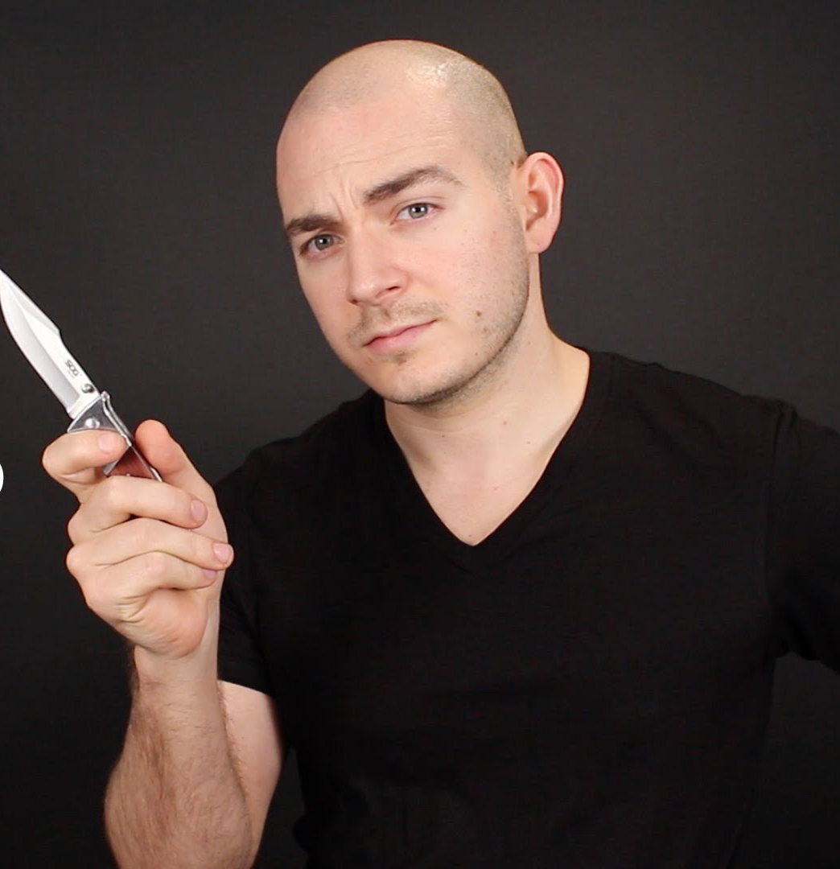
Does evil exist?
Notes:
The simple answer is, ”Yes. Evil exists. In fact, it exists in you and me.” This is why we must repent.

Slide 6
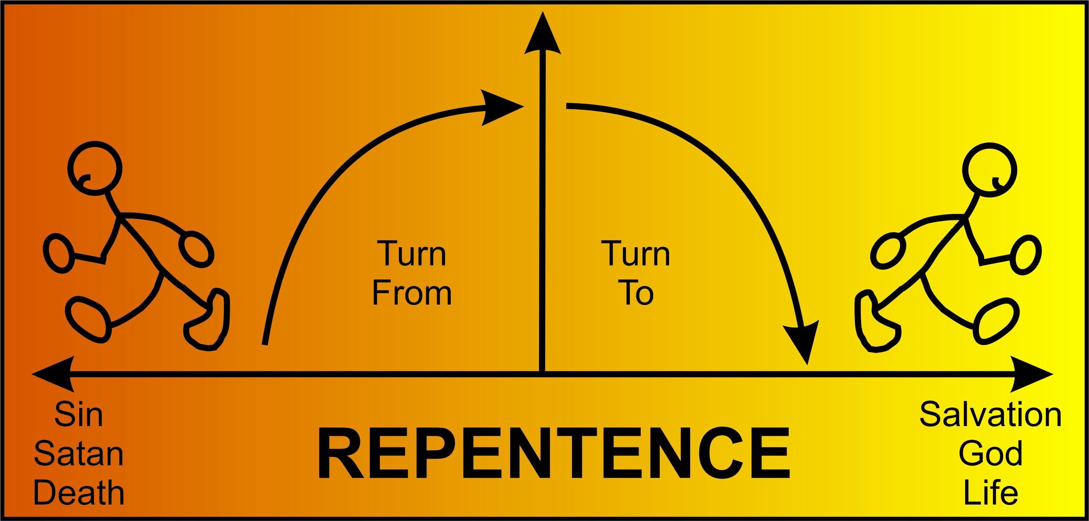
REPENTANCE?
Turn
From
Turn
To
Sin
Satan
Death
Salvation
God
Life
Notes:
But what does it mean to repent? Perhaps you have been told that repentance means “to turn”—to turn from sin, Satan, and death to turn to salvation, God, and life. But is that correct?

Slide 7
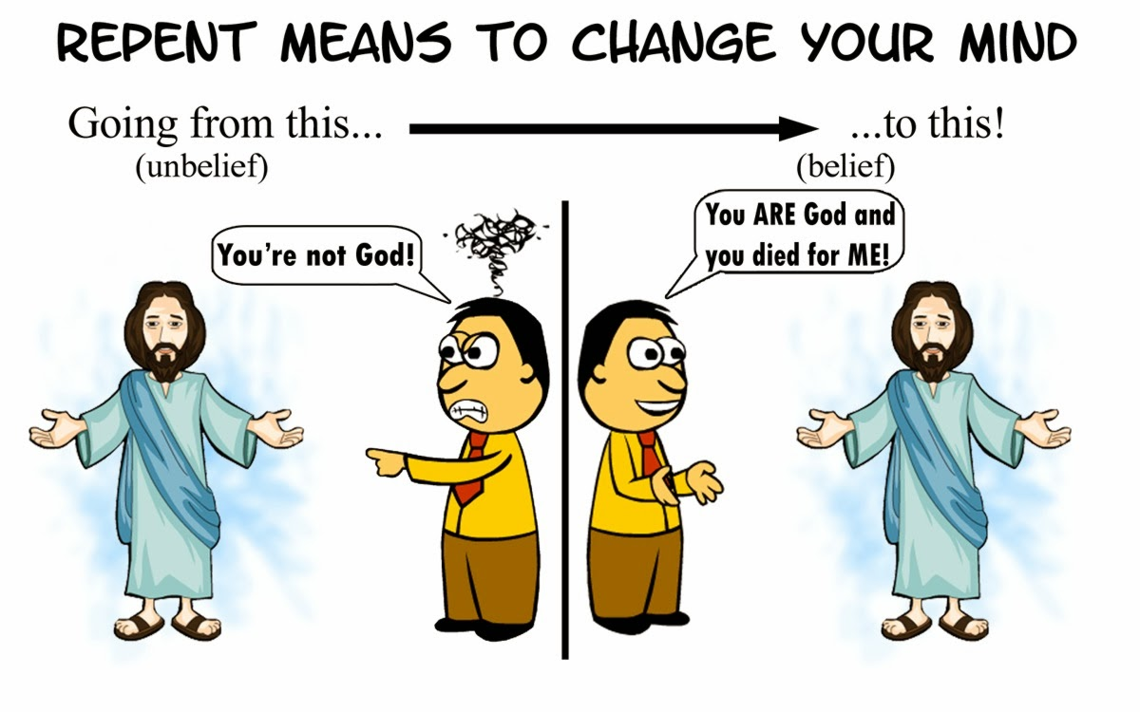
Repent Means to Change Your Mind
Going from this…
(unbelief)
to this…
(belief)
You’re not God!
You ARE God and you died for ME!
Notes:
Biblically, repentance means to change your mind about who Jesus is and what saves you. It means going from unbelief where we say Jesus is not God to belief that Jesus is God and died for us.

Slide 8

How should you repent?
How should you change your mind about evil, Jesus, and your sin?
Notes:
Here is where the book of Lamentations can help.

Slide 9
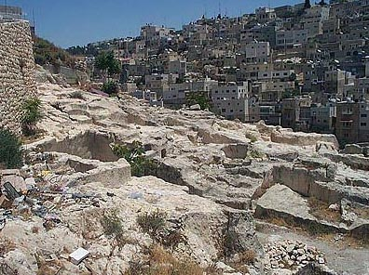
Jeremiah's Two Glimpses of Jerusalem's Fall
494
Fall of Jerusalem
Book of Jeremiah
—————
Looking Ahead
(Warning)
Book of Lamentations
—————
Looking
Back
(Mourning)
—The Daily Walk

Slide 10
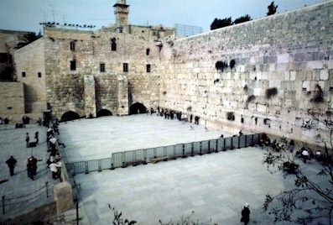
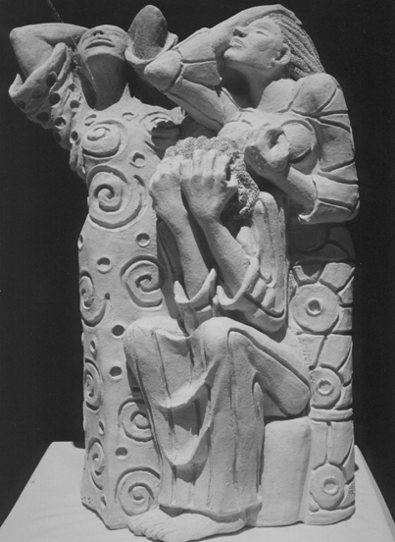
L A M E N T A T I O N S
Notes:
The city is destroyed. Now what should Judah do?

Slide 11
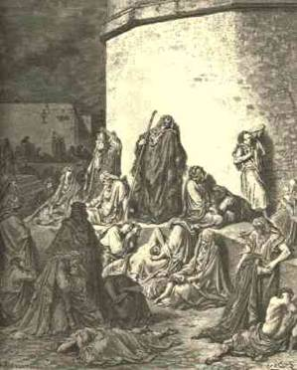
Historical Background
494
Directly after Jerusalem's destruction in 586 BC
Davidic King – the Lord's anointed – deposed and exiled
All but poorest exiled
Temple desecrated and burned
Perspective needed

Slide 12
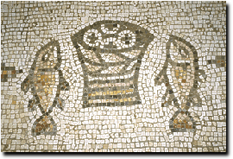
Genre
495
Kings
Concrete details
Facts
Lamentations
vivid sensory imagery
dates and names lacking
no sequential ordering
verse not prose
no names for the slain
no private grief shown

Slide 13

Name and Place
494
494
427
Hebrew Title
Heb: "eka"
Eng: "How terrible! Alas!"
Five Scrolls
Lamentations
Ruth
Ecclesiastes
Song of Songs
Esther
Feast Read:
9th of Ab
Pentecost
Tabernacles
Passover
Purim

Slide 14
Acrostic Structure
1
2
3
4
5
495
AAA
BBB
CCC
DDD
EEE
FFF
GGG
HHH
III
Note: The Hebrew alphabet has 22 consonants
A
B
C
A
B
C
A
B
C
Verses
22
22
66
22
22
Notes:
Lamentations is also the only Bible book whose basic structure forms an acrostic. All chapters (except chapter 3) have 22 verses, each beginning with successive letters of the Hebrew alphabet (except chapter 5). Chapter 3 has 66 verses with each letter repeated three times. The pattern may be for easy memorization or to emphasize the complete nature of suffering for sin (Dyer, BKC, 1:1211).

Slide 15

Chiastic Structure
495
1
2
3
4
5
Jeremiah's Response
The Lord's Anger
God's Judgment
Focal Point
Jerusalem's Desolation
Remnant Response
Notes:
Not only does the book use multiple acrostics but it has a chiastic structure as well. In other words, certain elements reappear in a deliberate order later in the book. Chapters 1 and 5 both depict Jerusalem’s destruction from the viewpoint of the inhabitants, chapters 2 and 4 both describe God’s view, and the center of the book (chap. 3) shows Jeremiah’s response.
The point of drawing attention to chapter 3 is to instruct each of us to imitate Jeremiah's individual response of repentance. Do you just let your calamity pass without really learning from it or do you fall upon God in a spirit of genuine remorse for your sin?

Slide 16
Lamentations
493
Five ways to repent…
Emotions of and Reasons for the Fall
Fall Described |  | Judgment Acknowledged |  | Jeremiah's Feelings | Trusting Leaders | Prayer
Chapter 1 |  | Chapter 2 |  | Chapter 3 | Chapter 4 | Chapter 5
The Suffering |  | The Cause |  | The Hope | The Reason | The Lament
3 Line Acrostic (22 verses) |  | 3 Line Acrostic (22 verses) |  | 1 Line Acrostic (66 verses) | 2 Line Acrostic (22 verses) | 1 Line Not Acrostic (22 verses)
People |  | God |  | Prophet | God | People
Third Person Singular ("she") 1:1-11 | First Person Singular ("I") 1:12-22 | Third Person Singular ("she") 2:1-10 | First Person Singular ("I") 2:11–4:22 |  |  | First Person Plural ("us/our") 5:1-22
Jerusalem (586 BC)
Notes:
Lamentations gives five ways to repent—for the Jews and for us.

Slide 17
Slides on
Lamentations 1

Slide 18
Lamentations
493
Five ways to repent…
Emotions of and Reasons for the Fall
Fall Described |  | Judgment Acknowledged |  | Jeremiah's Feelings | Trusting Leaders | Prayer
Chapter 1 |  | Chapter 2 |  | Chapter 3 | Chapter 4 | Chapter 5
The Suffering |  | The Cause |  | The Hope | The Reason | The Lament
3 Line Acrostic (22 verses) |  | 3 Line Acrostic (22 verses) |  | 1 Line Acrostic (66 verses) | 2 Line Acrostic (22 verses) | 1 Line Not Acrostic (22 verses)
People |  | God |  | Prophet | God | People
Third Person Singular ("she") 1:1-11 | First Person Singular ("I") 1:12-22 | Third Person Singular ("she") 2:1-10 | First Person Singular ("I") 2:11–4:22 |  |  | First Person Plural ("us/our") 5:1-22
Jerusalem (586 BC)
Admit
your
need
Notes:
Don’t cover up the price of your sin.

Slide 19
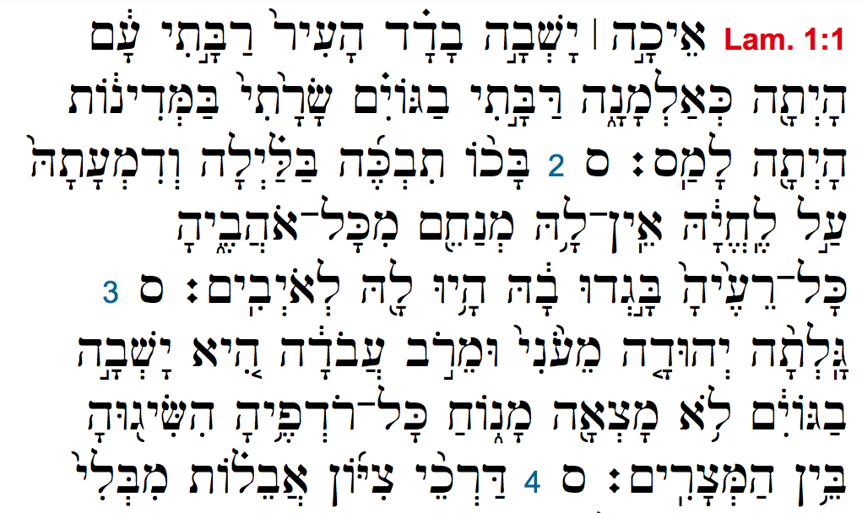
Lamentations 1 Hebrew Acrostic
= "A"
= "B"
= "C"
= "D"
Notes:
Each verse begins with the next letter of the Hebrew alphabet. Verse 1 with the Hebrew equivalent of "A," verse 2 with "B," etc.

Slide 20
"[Alas!] How deserted lies the city, once so full of people!
How like a widow is she, who once was great among the nations!
She who was queen among the provinces has now become a slave.
² Bitterly she weeps at night, tears are upon her cheeks.
Among all her lovers there is none to comfort her.
All her friends have betrayed her; they have become her enemies.
³ [Coming] after affliction and harsh labor,
Judah has gone into exile.
She dwells among the nations; she finds no resting place.
All who pursue her have overtaken her in the midst of her distress"
(Lamentations 1:1-3 NIV adapted).
= "A"
= "B"
= "C"
Notes:
Here is what it would look like in English.

Slide 21
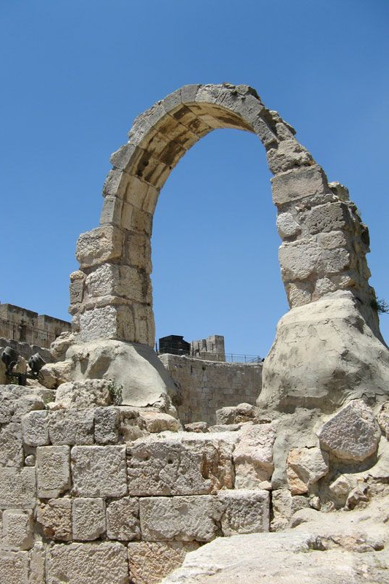
"The roads to Jerusalem are in mourning, for crowds no longer come to celebrate the festivals.
The city gates are silent, her priests groan, her young women are crying— how bitter is her fate!"
(Lam 1:4 NLT).
Notes:
Jerusalem’s rebellion against God led to a horrible siege (Lam 1).

Slide 22
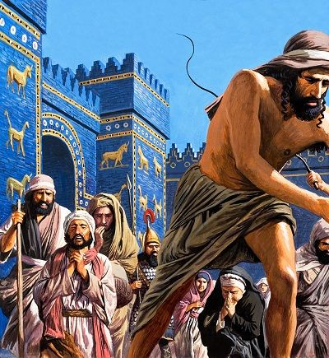
"Her oppressors have become her masters, and her enemies prosper, for the LORD has punished Jerusalem for her many sins.
Her children have been captured and taken away to distant lands"
(Lam 1:5 NLT).
Notes:
The fall of Jerusalem from prominence to lowliness reminds the nation of the heights the city enjoyed by grace before God's judgment (1:1-11).

Slide 23
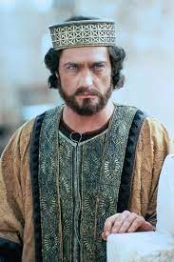
"All the majesty of beautiful Jerusalem has been stripped away.
Her princes are like starving deer searching for pasture.
They are too weak to run from the pursuing enemy"
(Lam 1:6 NLT).
Notes:
The fall of Jerusalem from prominence to lowliness reminds the nation of the heights the city enjoyed by grace before God's judgment (1:1-11).

Slide 24
Parallels between Lamentations
and Deuteronomy
496
Lamentations |  | Deuteronomy
1:3 | She dwells among the nations; she finds no resting place. | 28:65 | Among those nations you will find no repose, no resting place for the sole of your foot.
1:5 | Her foes have become her masters. | 28:44 | He will be the head, but you will be the tail.
1:5 | Her children have gone into exile, captive before the foe. | 28:32 | Your sons and daughters will be given to another nation.
1:6 | In weakness they have fled before the pursuer. | 28:25 | The LORD will cause you to be defeated before your enemies. You will come at them from one direction but flee from them in seven.
1:18 | My young men and maidens have gone into exile. | 28:41 | You will have sons and daughters but you will not keep them, because they will go into captivity.
Bible Knowledge Commentary, 1:1209
Notes:
God had told Israel over 800 years before that he would judge his people for their sin in the "Blessings and Cursings" chapter of Deuteronomy 28. The parallels are striking, almost quoting these warnings of Moses word-for-word. Through this God was telling them, "I told you so!” Lamentations refers back to Deuteronomy 28 at least 15 times!

Slide 25
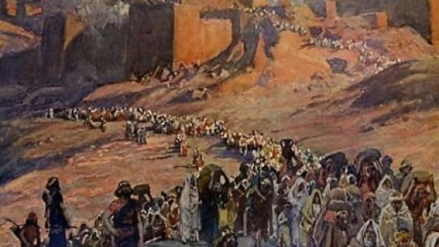
"He has sent fire from heaven that burns in my bones. He has placed a trap in my path and turned me back. He has left me devastated, racked with sickness all day long"
(Lam 1:12 NLT).
Notes:
Jerusalem confesses her deserved desolation with the agony the people feel over the awful effects of rebellion against God (1:12-22).
Here the language switches from third person (“it”) to first person (“I”) as if the city could speak for itself.

Slide 26
Lamentations
493
Five ways to repent…
Emotions of and Reasons for the Fall
Fall Described |  | Judgment Acknowledged |  | Jeremiah's Feelings | Trusting Leaders | Prayer
Chapter 1 |  | Chapter 2 |  | Chapter 3 | Chapter 4 | Chapter 5
The Suffering |  | The Cause |  | The Hope | The Reason | The Lament
3 Line Acrostic (22 verses) |  | 3 Line Acrostic (22 verses) |  | 1 Line Acrostic (66 verses) | 2 Line Acrostic (22 verses) | 1 Line Not Acrostic (22 verses)
People |  | God |  | Prophet | God | People
Third Person Singular ("she") 1:1-11 | First Person Singular ("I") 1:12-22 | Third Person Singular ("she") 2:1-10 | First Person Singular ("I") 2:11–4:22 |  |  | First Person Plural ("us/our") 5:1-22
Jerusalem (586 BC)
Admit
your
need
Do you confess that your sin has put you into a sad state?
Notes:
When was the last time you confessed a sin to God?
Was that a while back because you sin less now—or because you are growing colder to God?

Slide 27
Slides on
Lamentations 2

Slide 28
Lamentations
493
Five ways to repent…
Emotions of and Reasons for the Fall
Fall Described |  | Judgment Acknowledged |  | Jeremiah's Feelings | Trusting Leaders | Prayer
Chapter 1 |  | Chapter 2 |  | Chapter 3 | Chapter 4 | Chapter 5
The Suffering |  | The Cause |  | The Hope | The Reason | The Lament
3 Line Acrostic (22 verses) |  | 3 Line Acrostic (22 verses) |  | 1 Line Acrostic (66 verses) | 2 Line Acrostic (22 verses) | 1 Line Not Acrostic (22 verses)
People |  | God |  | Prophet | God | People
Third Person Singular ("she") 1:1-11 | First Person Singular ("I") 1:12-22 | Third Person Singular ("she") 2:1-10 | First Person Singular ("I") 2:11–4:22 |  |  | First Person Plural ("us/our") 5:1-22
Jerusalem (586 BC)
Admit
your
need
Admit
your
fault
Notes:
Don’t make excuses by blaming someone else for your sin.

Slide 29
"The Lord in his anger has cast a dark shadow over beautiful Jerusalem.
The fairest of Israel's cities lies in the dust, thrown down from the heights of heaven.
In his day of great anger, the Lord has shown no mercy even to his Temple" (Lam 2:1 NLT).
Notes:
God said that he caused Jerusalem's destruction (Lam 2).
2:1-2 is Adonai (“Lord”) rather than the normal Yahweh (“LORD”).

Slide 30
"Without mercy the Lord has destroyed every home in Israel.
In his anger he has broken down the fortress walls of beautiful Jerusalem.
He has brought them to the ground, dishonoring the kingdom and its rulers"
(Lam 2:2 NLT).
Notes:
God caused the destruction of the city and its covenantal institutions to help his people see this as his judgment (2:1-10).
2:1-2 is Adonai (“Lord”) rather than the normal Yahweh (“LORD”).

Slide 31
"All the strength of Israel vanishes beneath his fierce anger.
The Lord has withdrawn his protection as the enemy attacks.
He consumes the whole land of Israel like a raging fire"
(Lam 2:3 NLT).

Slide 32
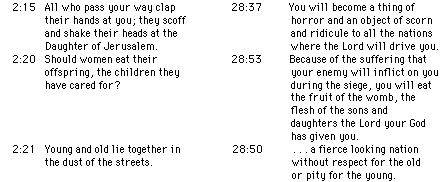
Parallels between Lamentations
and Deuteronomy
496
Lamentations |  | Deuteronomy
2:15 | All who pass your way clap their hands at you; they scoff and shake their heads at the Daughter of Jerusalem. | 28:37 | You will become a thing of horror and an object of scorn and ridicule to all the nations where the LORD will drive you.
2:20 | Should women eat their offspring, the children they have cared for? | 28:53 | Because of the suffering that your enemy will inflict on you during the siege, you will eat the fruit of the womb, the flesh of the sons and daughters the LORD your God has given you.
2:21 | Young and old lie together in the dust of the streets. | 28:50 | …a fierce-looking nation without respect for the old or pity for the young.
Bible Knowledge Commentary, 1:1209

Slide 33
Prophetic Curses
220
Why?
Exile
Deut 28
Notes:
Jeremiah's prophecy and Lamentations record his eyewitness account of Babylon's siege and destruction of Jerusalem for the nation's sin, the Holy Spirit moved him to record an historical compilation which provides the context and justification for God's judgment upon these two nations. The leaders and the people sinned through ungodliness and idolatry, and true to the curses of Deut. 28, God gave the people the consequences of their obedience.

Slide 34
Lamentations 2:15 (NIV)
    "Is this the city that was called
    the perfection of beauty,
    the joy of the whole earth?"
Notes:
Jeremiah laments the city's condition so that all would admit this as God’s judgment and seek his mercy (2:11-22).

Slide 35
Lamentations
493
Five ways to repent…
Emotions of and Reasons for the Fall
Fall Described |  | Judgment Acknowledged |  | Jeremiah's Feelings | Trusting Leaders | Prayer
Chapter 1 |  | Chapter 2 |  | Chapter 3 | Chapter 4 | Chapter 5
The Suffering |  | The Cause |  | The Hope | The Reason | The Lament
3 Line Acrostic (22 verses) |  | 3 Line Acrostic (22 verses) |  | 1 Line Acrostic (66 verses) | 2 Line Acrostic (22 verses) | 1 Line Not Acrostic (22 verses)
People |  | God |  | Prophet | God | People
Third Person Singular ("she") 1:1-11 | First Person Singular ("I") 1:12-22 | Third Person Singular ("she") 2:1-10 | First Person Singular ("I") 2:11–4:22 |  |  | First Person Plural ("us/our") 5:1-22
Jerusalem (586 BC)
Admit
your
need
Admit
your
fault
Do you say the same thing that God says about your sin?
Notes:
James Boice says, “If you keep close to God, you will keep from sin.
But if you sin persistently, you will fall away from God. Then you will rename the sin.
You will not talk about pride, the great sin; you will call it “self-esteem,” “self-worth,” or what is “due to me.”
You will not talk about gluttony and materialism; you will talk about “the good life.”
You will not talk about disobedience; you will talk about “shortcomings.”
You will not talk about the Ten Commandments and your violation of them; you will talk about your “mistakes.”
It is only when you draw close to God that these things will become increasingly sinful in your sight”
(https://www.ligonier.org/blog/renaming-sin/).
Likewise, we also refuse to use the word “immorality” as if there is no absolute standard.

Slide 36
Slides on
Lamentations 3

Slide 37
Lamentations
493
Five ways to repent…
Emotions of and Reasons for the Fall
Fall Described |  | Judgment Acknowledged |  | Jeremiah's Feelings | Trusting Leaders | Prayer
Chapter 1 |  | Chapter 2 |  | Chapter 3 | Chapter 4 | Chapter 5
The Suffering |  | The Cause |  | The Hope | The Reason | The Lament
3 Line Acrostic (22 verses) |  | 3 Line Acrostic (22 verses) |  | 1 Line Acrostic (66 verses) | 2 Line Acrostic (22 verses) | 1 Line Not Acrostic (22 verses)
People |  | God |  | Prophet | God | People
Third Person Singular ("she") 1:1-11 | First Person Singular ("I") 1:12-22 | Third Person Singular ("she") 2:1-10 | First Person Singular ("I") 2:11–4:22 |  |  | First Person Plural ("us/our") 5:1-22
Jerusalem (586 BC)
Admit
your
need
Admit
your
fault
Hope
in
God
Notes:
Express your trust in the LORD alone.

Slide 38
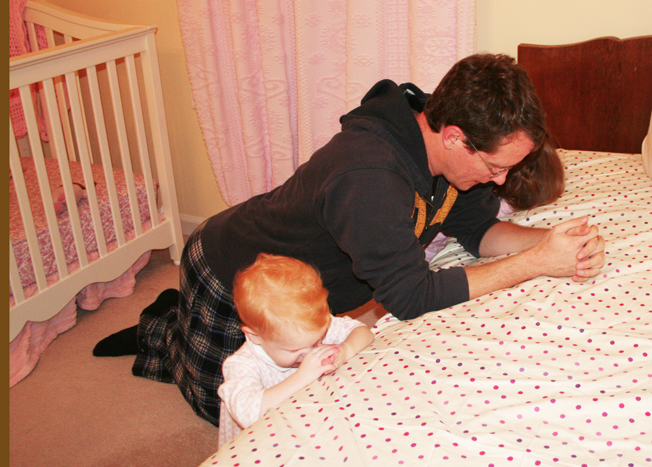
Chapter 3 is a Model of Confession
Notes:
We all need models of prayer!

Slide 39
Lamentations 1 Hebrew Acrostic
= "A"
= "B"
= "C"
= "D"
Notes:
Remember that chapter 1 had a succession of beginning letters starting with the equivalent of letter A?

Slide 40
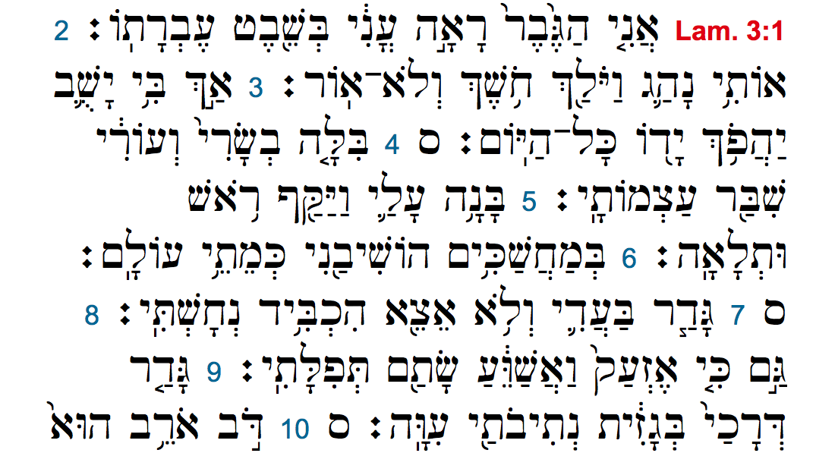
Lamentations 3 Hebrew Acrostic
= "A"
= "A"
= "A"
= "B"
= "B"
= "B"
= "C"
= "C"
= "C"
= "D"
Notes:
Now in chapter 3 we see the letter “A” beginning three verses in a row, then “B” three verses, etc.

Slide 41
"I am the one who has seen the afflictions that come from the rod of the LORD's anger.
² He has led me into darkness, shutting out all light.
³ He has turned his hand against me again and again, all day long"
(Lam 3:1-3 NLT).
Notes:
Jeremiah repents in his affliction that his confidence is in God (Lam 3).

Slide 42
"He has made my skin and flesh grow old.
He has broken my bones.
⁵ He has besieged and surrounded me with anguish and distress.
⁶ He has buried me in a dark place, like those long dead"
(Lam 3:4-6 NLT).
Notes:
Jeremiah describes his afflictions in general, poetic terms to identify with the suffering people (3:1-18).

Slide 43
"He has walled me in, and I cannot escape.
He has bound me in heavy chains.
⁸ And though I cry and shout, he has shut out my prayers.
⁹ He has blocked my way with a high stone wall; he has made my road crooked"
(Lam 3:7-9 NLT).

Slide 44

"I remember my affliction and my wandering, the bitterness and the gall.
²⁰I well remember them, and my soul is downcast within me.
²¹Yet this I call to mind and therefore I have hope:
²²Because of the LORD's great love we are not consumed, for his compassions never fail.
²³They are new every morning; great is your faithfulness.
²⁴I say to myself, 'The LORD is my portion; therefore I will wait for him'"
(Lam 3:19-24 NLT).
Notes:
Jeremiah puts his hope in God to model how to pray for mercy (3:19-39).

Slide 45
"The LORD is good to those whose hope is in him, to the one who seeks him;
²⁶it is good to wait quietly for the salvation of the LORD.
²⁷It is good for a man to bear the yoke while he is young.
²⁸Let him sit alone in silence, for the LORD has laid it on him.
²⁹Let him bury his face in the dust— there may yet be hope.”
(Lam 3:25-29 NLT)

Slide 46
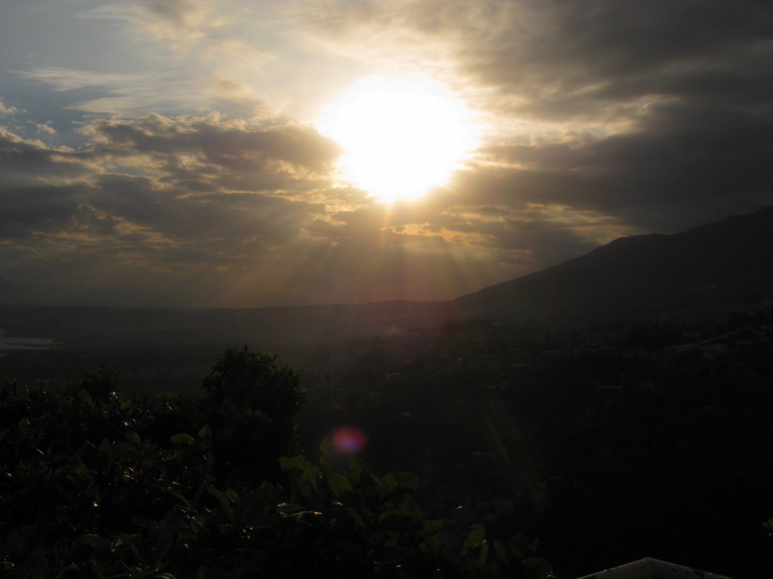

Great is Thy Faithfulness
(Lamentations 3:22-23)

Slide 47

Great is Thy faithfulness 2/6
Great is Thy faithfulness!
Great is Thy faithfulness!
Morning by morning new mercies I see!
All I have needed
Thy hand hath provided;
Great is Thy faithfulness,
Lord, unto me!

Slide 48
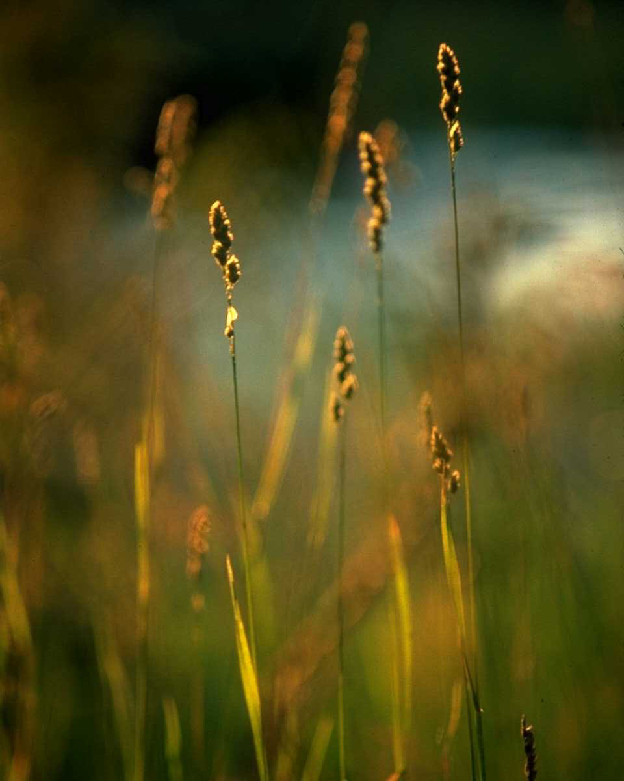
Great is Thy faithfulness 3/6
Summer and winter
and springtime and harvest,
Sun, moon and stars
in their courses above
Join with all nature in manifold witness
To Thy great faithfulness,
mercy and love

Slide 49
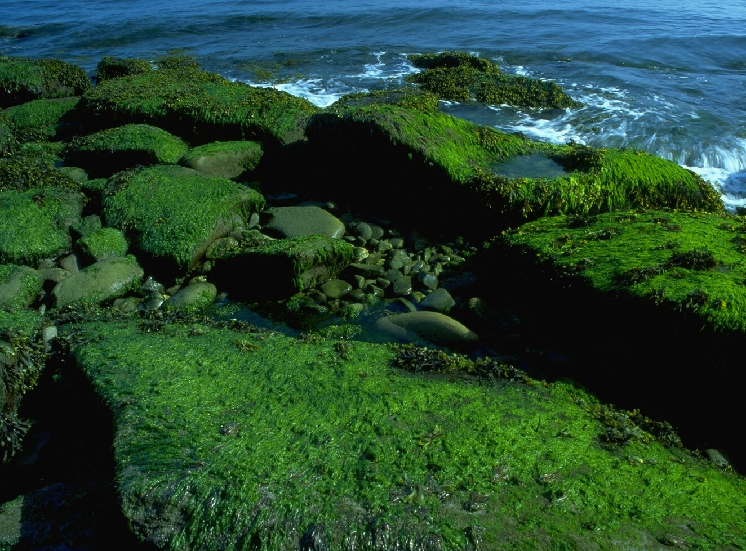
Great is Thy faithfulness 4/6
Great is Thy faithfulness!
Great is Thy faithfulness!
Morning by morning new mercies I see!
All I have needed
Thy hand hath provided;
Great is Thy faithfulness,
Lord, unto me!

Slide 50
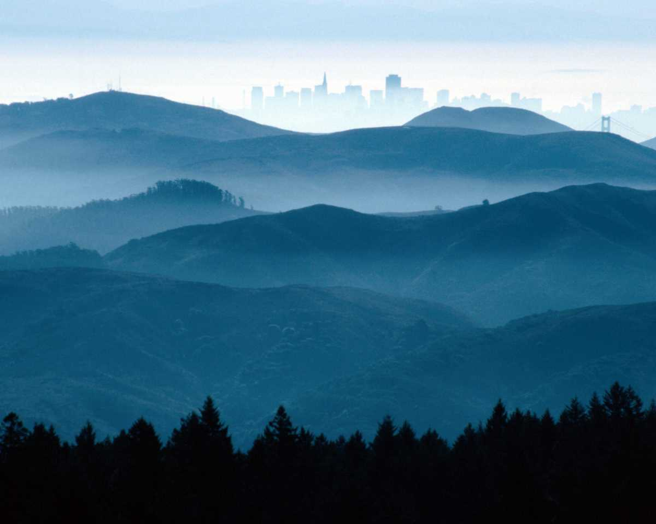
Great is Thy faithfulness 5/6
Pardon for sin and
a peace that endureth;
Thine own dear presence
to cheer and to guide.
Strength for today
and bright hope for tomorrow;
Blessings all mine,
with ten thousand beside!

Slide 51
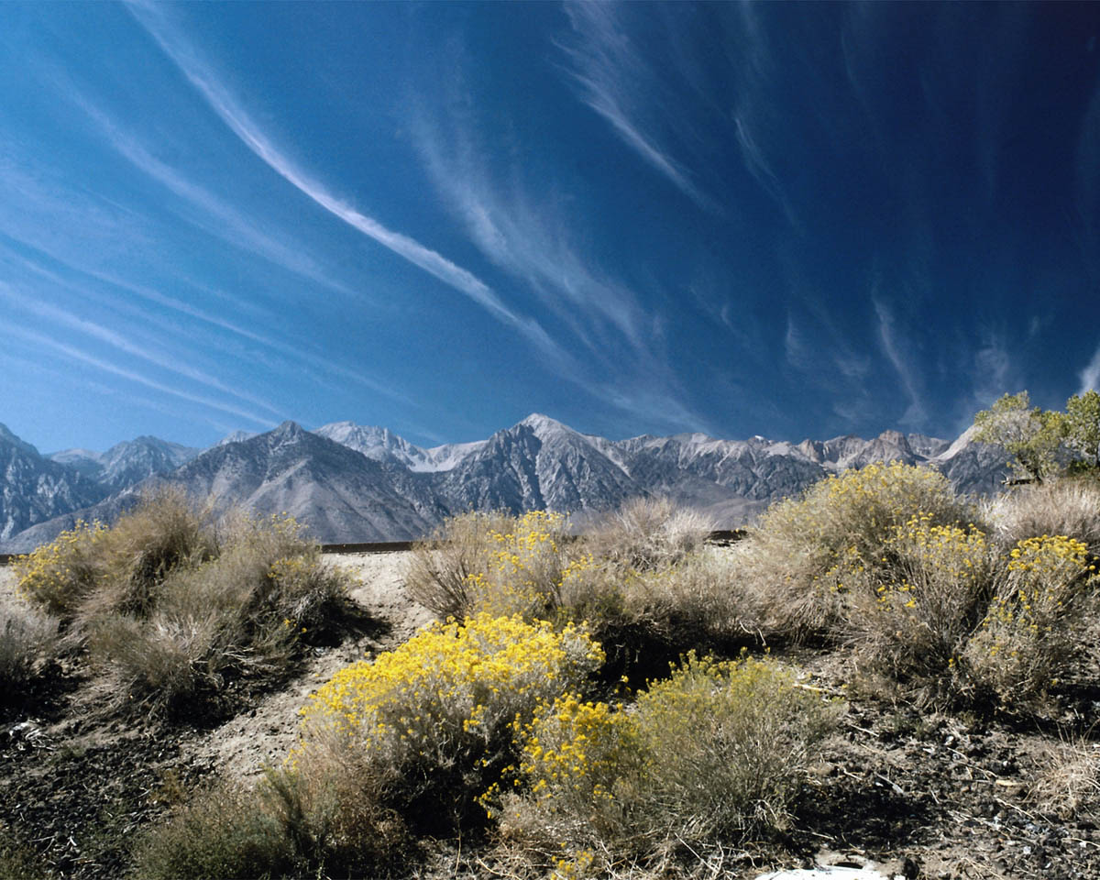
Great is Thy faithfulness 6/6
Great is Thy faithfulness!
Great is Thy faithfulness!
Morning by morning new mercies I see!
All I have needed
Thy hand hath provided;
Great is Thy faithfulness,
Lord, unto me!

Slide 52
Lamentations
493
Five ways to repent…
Emotions of and Reasons for the Fall
Fall Described |  | Judgment Acknowledged |  | Jeremiah's Feelings | Trusting Leaders | Prayer
Chapter 1 |  | Chapter 2 |  | Chapter 3 | Chapter 4 | Chapter 5
The Suffering |  | The Cause |  | The Hope | The Reason | The Lament
3 Line Acrostic (22 verses) |  | 3 Line Acrostic (22 verses) |  | 1 Line Acrostic (66 verses) | 2 Line Acrostic (22 verses) | 1 Line Not Acrostic (22 verses)
People |  | God |  | Prophet | God | People
Third Person Singular ("she") 1:1-11 | First Person Singular ("I") 1:12-22 | Third Person Singular ("she") 2:1-10 | First Person Singular ("I") 2:11–4:22 |  |  | First Person Plural ("us/our") 5:1-22
Jerusalem (586 BC)
Admit
your
need
Admit
your
fault
Hope
in
God
Do you have misplaced hope—or is it in God alone?
Notes:
Do you sing, “Great is YOUR Faithfulness”?
Or do you sing, “Great is MY Faithfulness”?
Are you placing your trust in Jesus alone as your hope in God?

Slide 53
Slides on
Lamentations 4

Slide 54
Lamentations
493
Five ways to repent…
Emotions of and Reasons for the Fall
Fall Described |  | Judgment Acknowledged |  | Jeremiah's Feelings | Trusting Leaders | Prayer
Chapter 1 |  | Chapter 2 |  | Chapter 3 | Chapter 4 | Chapter 5
The Suffering |  | The Cause |  | The Hope | The Reason | The Lament
3 Line Acrostic (22 verses) |  | 3 Line Acrostic (22 verses) |  | 1 Line Acrostic (66 verses) | 2 Line Acrostic (22 verses) | 1 Line Not Acrostic (22 verses)
People |  | God |  | Prophet | God | People
Third Person Singular ("she") 1:1-11 | First Person Singular ("I") 1:12-22 | Third Person Singular ("she") 2:1-10 | First Person Singular ("I") 2:11–4:22 |  |  | First Person Plural ("us/our") 5:1-22
Jerusalem (586 BC)
Admit
your
need
Admit
your
fault
Hope
in
God
Distrust your
leaders
Notes:
Hmmm, this sounds incriminating but I also can’t ultimately trust my leaders.

Slide 55
"How the gold has lost its luster!
Even the finest gold has become dull.
The sacred gemstones lie scattered in the streets!"
(Lam 4:1 NLT).
Notes:
Jerusalem’s pre-siege glory contrasts with the contemptible siege conditions to recall God's wrath for breaking their covenant (4:1-11).

Slide 56
"See how the precious children of Jerusalem, worth their weight in fine gold, are now treated like pots of clay made by a common potter"
(Lam 4:2 NLT).

Slide 57
"Even the jackals feed their young, but not my people Israel.
They ignore their children's cries, like ostriches in the desert"
(Lam 4:3 NLT).

Slide 58
"Not a king in all the earth— no one in all the world— would have believed that an enemy could march through the gates of Jerusalem.
¹³ Yet it happened because of the sins of her prophets and the sins of her priests, who defiled the city by shedding innocent blood"
(Lam 4:12-13 NLT).
Notes:
The city fell because the people trusted their prophets, priests, elders, alliances, and king rather than God but they can trust him now (4:12-20).

Slide 59
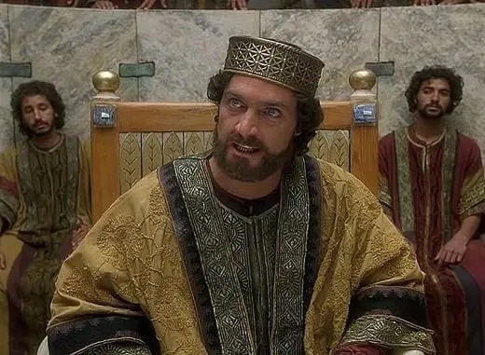
"Our king—the LORD’s anointed, the very life of our nation— was caught in their snares.
We had thought that his shadow would protect us against any nation on earth!"
(Lam 4:20 NLT).

Slide 60
Contrasts Between Edom & Israel in Lamentations 4:21-22
499
Present Condition
Future Condition
Fall of Jerusalem
Edom
Rejoicing—————
Israel Punished
Israel Restored
—————
Edom Punished
Bible Knowledge Commentary, 1:1221
Notes:
Jeremiah sarcastically calls on Edom to rejoice over Jerusalem's doom but warns of their coming judgment as God is fair to all (4:21-22).

Slide 61
Lamentations
493
Five ways to repent…
Emotions of and Reasons for the Fall
Fall Described |  | Judgment Acknowledged |  | Jeremiah's Feelings | Trusting Leaders | Prayer
Chapter 1 |  | Chapter 2 |  | Chapter 3 | Chapter 4 | Chapter 5
The Suffering |  | The Cause |  | The Hope | The Reason | The Lament
3 Line Acrostic (22 verses) |  | 3 Line Acrostic (22 verses) |  | 1 Line Acrostic (66 verses) | 2 Line Acrostic (22 verses) | 1 Line Not Acrostic (22 verses)
People |  | God |  | Prophet | God | People
Third Person Singular ("she") 1:1-11 | First Person Singular ("I") 1:12-22 | Third Person Singular ("she") 2:1-10 | First Person Singular ("I") 2:11–4:22 |  |  | First Person Plural ("us/our") 5:1-22
Jerusalem (586 BC)
Admit
your
need
Admit
your
fault
Hope
in
God
Distrust your
leaders
Do you put more trust in your pastor than in God?
Notes:
Do you check what I say by the Bible or do you just accept what I say as the truth?
Do you read more of the Bible to yourself than I read to you?

Slide 62
Slides on
Lamentations 5

Slide 63
Lamentations
493
Five ways to repent…
Emotions of and Reasons for the Fall
Fall Described |  | Judgment Acknowledged |  | Jeremiah's Feelings | Trusting Leaders | Prayer
Chapter 1 |  | Chapter 2 |  | Chapter 3 | Chapter 4 | Chapter 5
The Suffering |  | The Cause |  | The Hope | The Reason | The Lament
3 Line Acrostic (22 verses) |  | 3 Line Acrostic (22 verses) |  | 1 Line Acrostic (66 verses) | 2 Line Acrostic (22 verses) | 1 Line Not Acrostic (22 verses)
People |  | God |  | Prophet | God | People
Third Person Singular ("she") 1:1-11 | First Person Singular ("I") 1:12-22 | Third Person Singular ("she") 2:1-10 | First Person Singular ("I") 2:11–4:22 |  |  | First Person Plural ("us/our") 5:1-22
Jerusalem (586 BC)
Admit
your
need
Admit
your
fault
Hope
in
God
Distrust your
leaders
Keep
looking
forward
Notes:
Trust that God will indeed restore you.

Slide 64
"LORD, remember what has happened to us.
See how we have been disgraced!
² Our inheritance has been turned over to strangers, our homes to foreigners.
³ We are orphaned and fatherless.
Our mothers are widowed"
(Lam 5:1-3 NLT).
Notes:
The city (“us/our”) laments to God so the remnant will feel their suffering (5:1-15).

Slide 65
"We have to pay for water to drink, and even firewood is expensive.
⁵ Those who pursue us are at our heels; we are exhausted but are given no rest.
⁶ We submitted to Egypt and Assyria to get enough food to survive.
⁷ Our ancestors sinned, but they have died— and we are suffering the punishment they deserved!” (Lam 5:4-7 NLT).

Slide 66
"Slaves have now become our masters; there is no one left to rescue us.
⁹ We hunt for food at the risk of our lives, for violence rules the countryside.
¹⁰ The famine has blackened our skin as though baked in an oven"
(Lam 5:8-10 NLT).

Slide 67
"Our enemies rape the women in Jerusalem and the young girls in all the towns of Judah.
¹² Our princes are being hanged by their thumbs, and our elders are treated with contempt.
¹³ Young men are led away to work at millstones, and boys stagger under heavy loads of wood.
¹⁴ The elders no longer sit in the city gates; the young men no longer dance and sing.
¹⁵ Joy has left our hearts; our dancing has turned to mourning"
(Lam 5:11-15 NLT).

Slide 68
"The garlands have fallen from our heads.
Weep for us because we have sinned.
¹⁷ Our hearts are sick and weary, and our eyes grow dim with tears.
¹⁸ For Jerusalem is empty and desolate, a place haunted by jackals"
(Lam 5:16-18 NLT).
Notes:
The city (“us/our”) confesses sin to exhort the remnant to repent (5:16-18).

Slide 69
"But LORD, you remain the same forever!
Your throne continues from generation to generation.
²⁰ Why do you continue to forget us?
Why have you abandoned us for so long?
²¹ Restore us,
O LORD, and bring us back to you again!
Give us back the joys we once had!
²² Or have you utterly rejected us?
Are you angry with us still?"
(Lam 5:19-22 NLT).
Notes:
The city (“us/our”) prays for restoration to encourage the remnant to hope for renewal (5:19-22).

Slide 70
Lamentations
493
Five ways to repent…
Emotions of and Reasons for the Fall
Fall Described |  | Judgment Acknowledged |  | Jeremiah's Feelings | Trusting Leaders | Prayer
Chapter 1 |  | Chapter 2 |  | Chapter 3 | Chapter 4 | Chapter 5
The Suffering |  | The Cause |  | The Hope | The Reason | The Lament
3 Line Acrostic (22 verses) |  | 3 Line Acrostic (22 verses) |  | 1 Line Acrostic (66 verses) | 2 Line Acrostic (22 verses) | 1 Line Not Acrostic (22 verses)
People |  | God |  | Prophet | God | People
Third Person Singular ("she") 1:1-11 | First Person Singular ("I") 1:12-22 | Third Person Singular ("she") 2:1-10 | First Person Singular ("I") 2:11–4:22 |  |  | First Person Plural ("us/our") 5:1-22
Jerusalem (586 BC)
Admit
your
need
Admit
your
fault
Hope
in
God
Distrust your
leaders
Keep
looking
forward
Do you pray for restoration?
Notes:
Trust that God will indeed restore you.

Slide 71
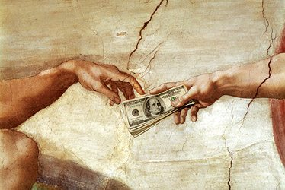

Notes:
Joel Osteen wrote the book entitled Your Best Life Now.
• John MacArthur’s comment on this was, “If you are living your best life now, then you are headed for hell.”
It’s easy to look at God only as the one who is supposed to give us money. He offers so much more!

Slide 72
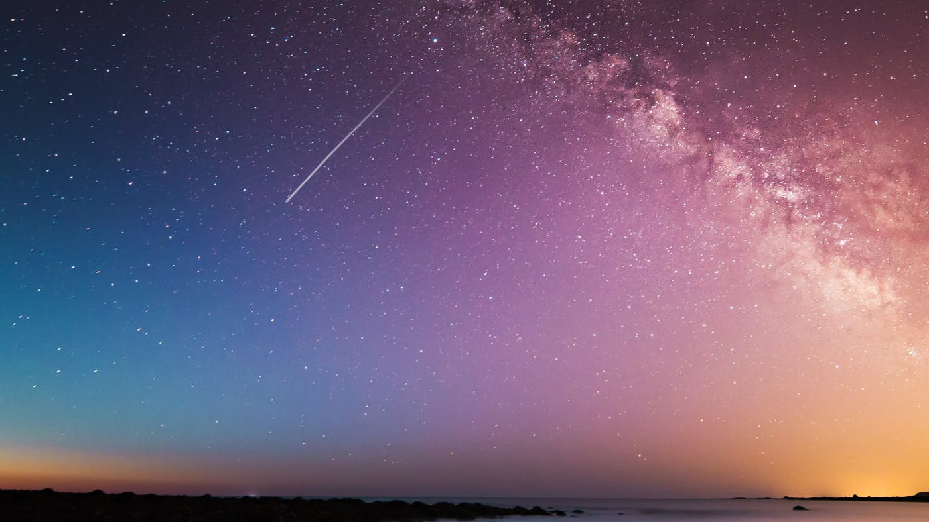
Notes:
Do you believe that your best days are ahead? You can if you trust in God’s full restoration of your life at death or the return of Christ.
Trust in the most trustworthy of all people—the only one who died for your sins and then proved it by rising from the dead!

Slide 73
How should you repent?
How should you change your mind about evil, Jesus, and your sin?
Notes:
The book of Lamentations can help us see in real terms what repentance looks like.

Slide 74
Main Idea
Be repentant over your sin by changing your mind to view sin as God does.
Lamentations
Notes:
We need to realign our thinking about our doing wrong—our depravity. God doesn’t excuse it, so neither should we.

Slide 75
Lamentations
493
Five ways to repent…
Emotions of and Reasons for the Fall
Fall Described |  | Judgment Acknowledged |  | Jeremiah's Feelings | Trusting Leaders | Prayer
Chapter 1 |  | Chapter 2 |  | Chapter 3 | Chapter 4 | Chapter 5
The Suffering |  | The Cause |  | The Hope | The Reason | The Lament
3 Line Acrostic (22 verses) |  | 3 Line Acrostic (22 verses) |  | 1 Line Acrostic (66 verses) | 2 Line Acrostic (22 verses) | 1 Line Not Acrostic (22 verses)
People |  | God |  | Prophet | God | People
Third Person Singular ("she") 1:1-11 | First Person Singular ("I") 1:12-22 | Third Person Singular ("she") 2:1-10 | First Person Singular ("I") 2:11–4:22 |  |  | First Person Plural ("us/our") 5:1-22
Jerusalem (586 BC)
Admit
your
need
Admit
your
fault
Hope
in
God
Distrust your
leaders
Keep
looking
forward
Notes:
1—Do you confess that your sin has put you into a sad state?
2—Do you say the same thing that God says about your sin?
3—Do you have misplaced hope—or is it in God alone?
4—Do you put more trust in me than in God?
5—Do you pray for restoration?

Slide 76
American Couple Believing 'Evil Is A Make-Believe Concept' Bike Through Territory Near Afghan Border. ISIS Stabs Them To Death.
Notes:
Remember the young American couple who took a year-long bike trip around the world, believing that evil was a make-believe concept? They took a fatal route in Tajikistan near the Afghan border, where alleged ISIS terrorists stabbed them to death. They let their guard down, not believing that evil was just around the corner.
________
American Couple Believing 'Evil Is A Make-Believe Concept' Bike Through Territory Near Afghan Border. ISIS Stabs Them To Death.
https://www.dailywire.com/news/34581/american-couple-believing-evil-make-believe-hank-berrien
Screenshot: CBS This Morning
By Hank Berrien
August 16, 2018 1.4m views
Accessed 15 Sep 2018

Slide 77
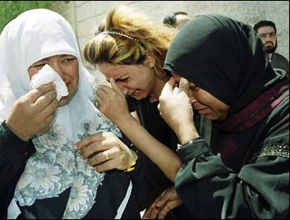
Application
493
Beware lest you think you stand and begin to take God's grace for granted.
When we are punished by God, our only hope lies in turning to our "Enemy"
(Huang Sabin)

Slide 78
Just trust me.
—God

Slide 79
Black

Slide 80


OT Preaching link at BibleStudyDownloads.org
Get this presentation and script for free!

